Slide 1
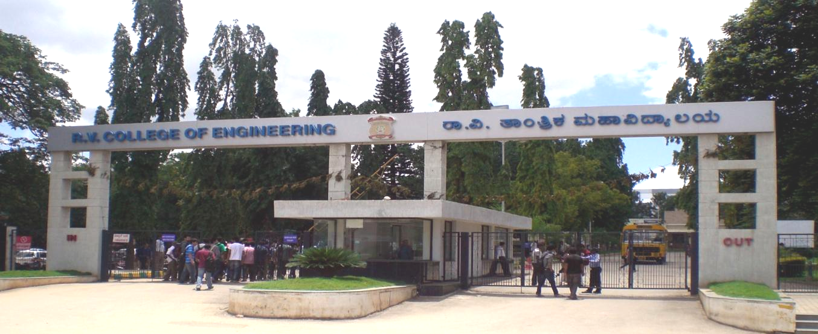
VIII Semester Major Project Phase - 2
Department of Computer Science
R V College of Engineering. Bangalore

Slide 2
VIII Semester Major Project Phase - 2
Department of Computer Science
R V College of Engineering. Bangalore

Slide 3
OAuth server for secure Business Services
Name | USN
Chirag R C | 1RV12CS023
N Sudeep | 1RV12CS057
Pareekshith K J | 1RV12CS062
Internal Guide:
Dr. Minal Moharir,
Associate Professor,
Dept. of Computer Science, RVCE
External Guide:
Mr. Anshul Agarwal,
Senior Architect,
Urban Ladder Home Décor Pvt. Ltd.
Computer Science and Eng., RVCE

Slide 4
Committee Members:
Dr. Shanta Rangaswamy,
Associate Professor,
Dept. of Computer Science, RVCE
Prof. Azra Nasreen,
Assistant Professor,
Dept. of Computer Science, RVCE
Prof. Pratiba D,
Assistant Professor,
Dept. of Computer Science, RVCE
Computer Science and Eng., RVCE

Slide 5
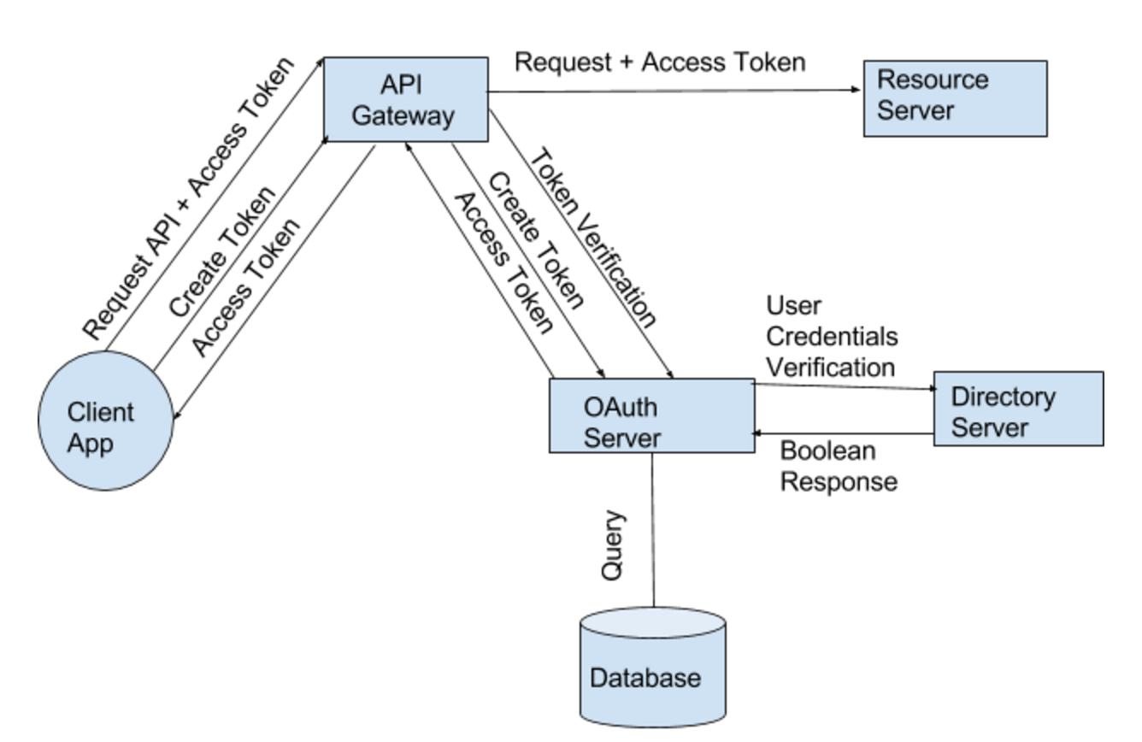
Detailed Methodology
Computer Science and Eng., RVCE

Slide 6
Detailed Methodology Contd.
Routing – Chirag
Authentication – Chirag
Throttling – Sudeep
Authorization - Pareekshith
Computer Science and Eng., RVCE

Slide 7
Routing
Token Creation – HTTP post request
Token Validation – HTTP get request
Resource Request – HTTP get request
Computer Science and Eng., RVCE

Slide 8





Authentication
Computer Science and Eng., RVCE

Slide 9

Throttling
Computer Science and Eng., RVCE

Slide 10
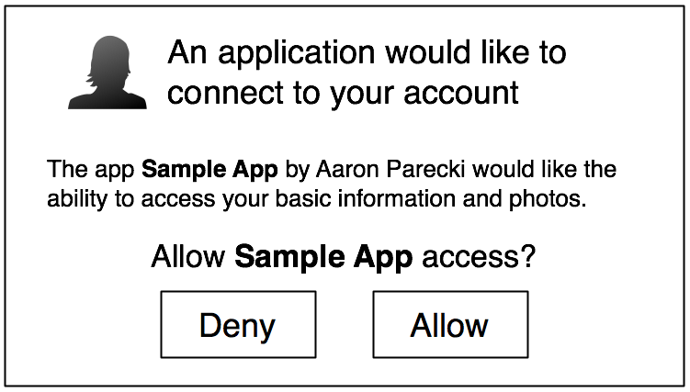
Authorization
Computer Science and Eng., RVCE

Slide 11
Literature Review
Computer Science and Eng., RVCE

Slide 12
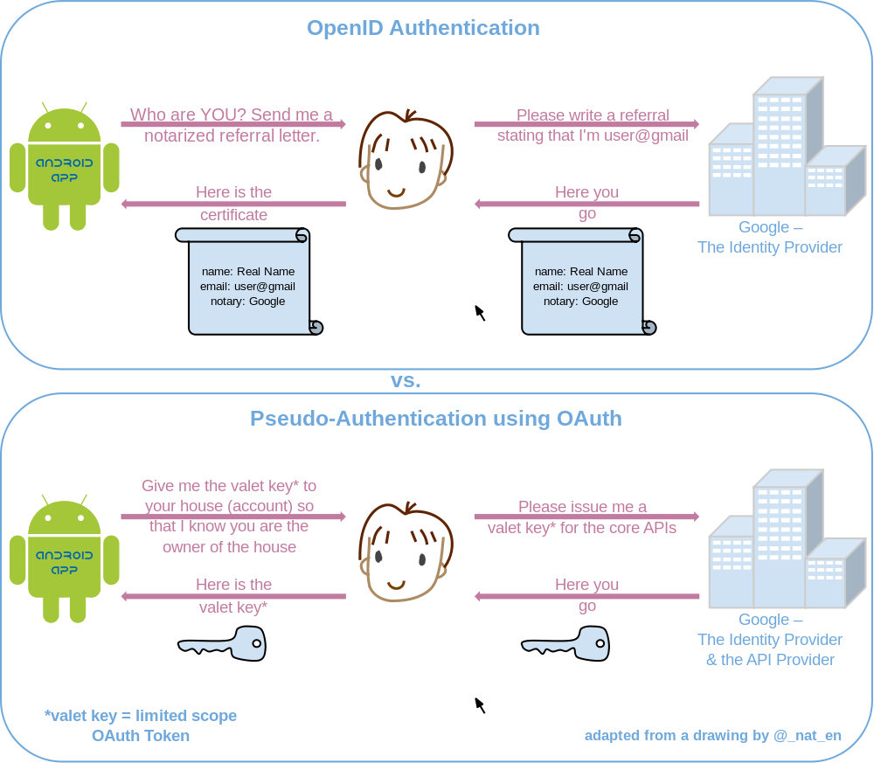
A survey on security issues of federated identity in the cloud computing
Computer Science and Eng., RVCE

Slide 13
Application Impersonation: Problems of OAuth and API Design in Online Social Networks
Types of Tokens
FIGT (Forged Implicit Grant Type)
CSRF attack
Expiring Token
Computer Science and Eng., RVCE

Slide 14

Computer Science and Eng., RVCE

Slide 15
_{Literature Survey}
Year, Name of the Journal/Conference | Title of the paper | Authors of the paper | Model/Sub Model used | Challenges of the paper | Limitations of the paper
2014, IEEE Journal on Computer Vision and Pattern Recognition | A policy validation framework for enterprise authorization specification | R Chandramouli | MOG [4] | Implementation of authorization framework | The framework uses XML to encode the enterprise authorization specification
Cloud Engineering (IC2E), 2014 IEEE International Conference on | Platform-level Support for Authorization in Cloud Services with OAuth 2 | Sendor, J. SAP Labs., Sophia-Antipolis, France Lehmann, Y. ; Serme, G. ; Santana de Oliveira, A. | KDE [5] | Strong authorization in cloud services | Only a JAVA based approach is mentioned
Notes:
<νυμβερ>

Slide 16
_{Literature Survey}
Year, Name of the Journal/Conference | Title of the paper | Authors of the paper | Model/Sub Model used | Challenges of the paper | Limitations of the paper
Journal of Engineering, Computers & Applied Sciences (JEC&AS) ISSN No: 2319‐5606 Volume 2, No.6, June 2013 | A Survey Paper on Social Sign-On Protocol OAuth 2.0 | Er. Gurleen Kaur, Er. Deepak Aggarwal | OAuth2 framework | Authentication, Authorization, Resource Request handling, Expiring token, Bearer token | CSRF attack,
E-Science (e-Science), 2012 IEEE 8th International Conference on 8-12 Oct. 2012 | Open Social based group access control framework for e-Science data infrastructure | Hui Zhang, Wenjun Wu , Zhenan Li | OSGAC | Using OAuth2, this paper introduces a novel Open Social based access control | Suitable for only e-Science data indrastructure

Slide 17
_{Literature Survey}
Year, Name of the Journal/Conference | Title of the paper | Authors of the paper | Model/Sub Model used | Challenges of the paper | Limitations of the paper
GoLang Conference, 2013 | GoHotDraw: Evaluating the Go Programming Language with Design Patterns | Frank Schmager, Nicholas Cameron, James Noble | HotDraw | Lack of known design pattern for Golang | Presents only 1 framework pattern
Communications, Computers and Signal Processing (PACRIM), 2013 IEEE Pacific Rim Conference on, 27-29 Aug 2013 | A security analysis of the OAuth protocol | Feng Yang, Manoharan S | Attacker model to study security vulnerabilities | Tackling abuse of authorization code | Does not present a viable solution

Slide 18
_{Literature Survey}
Year, Name of the Journal/Conference | Title of the paper | Authors of the paper | Model/Sub Model used | Challenges of the paper | Limitations of the paper
2011 International Conference on Communication Systems and Network Technologies | Formal Veriﬁcation of OAuth 2.0 using AlloyFramework | Suhas Pai, Yash Sharma, Sunil Kumar, Radhika M Pai and Sanjay Singh | Alloy modelling language for specification and Alloy analyzer for verification | Evaluation of correctness of OAuth2 protocol | Only identifies known security vulnerabilities
Institutt for datateknikk og informasjonsvitenskap , 2013 | Authentication and Authorization for Native Mobile Applications using OAuth 2.0 | Aas, Dag-Inge | Improving existing model | There are more security vulnerabilities for native mobile apps than webapps | The proposed improvement is specific to only Android OS

Slide 19
_{Thank You…….. ☺}

